Slide 1

North East University Bangladesh
Department of Computer Science and Engineering
2D Hand-Drawn Shape Completion
Presenting By,
Eftakhar Ahmed Arnob
ID: 190103020028
Ehtimum Rashed Chowdhury
ID: 190103020026
BSc(Engg) in CSE
4th year 2nd semester
Supervised By,
Noushad Sojib
Assistant Professor
Department of CSE
North East University Bangladesh

Slide 2


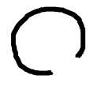

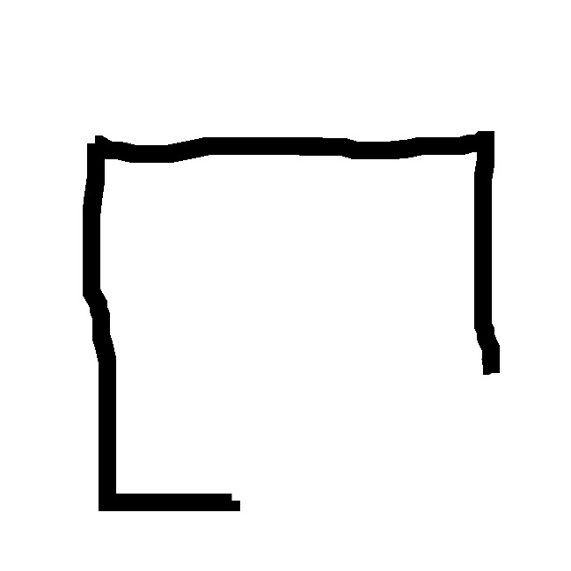
Introduction
The objective of our research is to complete two-dimensional hand-drawn sketches containing partially incomplete nonstandard shapes utilizing an encoder-decoder neural network.

Slide 3

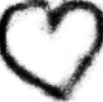

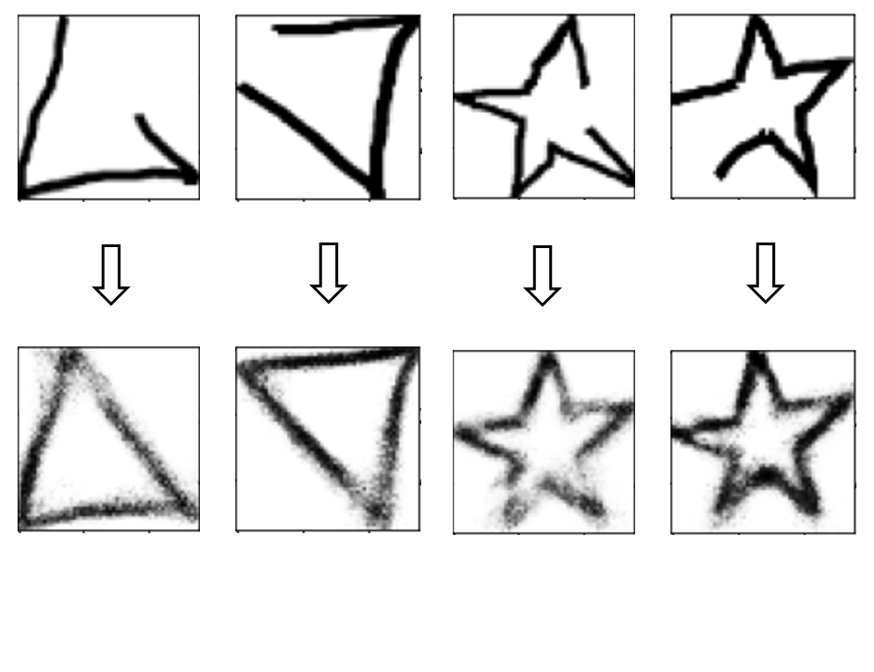
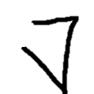
Our Goals
Generate images from partial hand-drawn inputs.
Maintain consistency between input and output.
Maintain the model's ability to preserve input rotation in output.

Slide 4
Our Encoder-Decoder Architecture
Copy & Concatenate
Encoder:
Layer 1 - Type: Dense - Shape: 2500 - Activation: LeakyRelu
Layer 2 - Type: Dense - Shape: 2000 - Activation: LeakyRelu
Layer 3 - Type: Dense - Shape: 1500 - Activation: LeakyRelu
Layer 4 - Type: Dense - Shape: 1000 - Activation: LeakyRelu
Layer 5 - Type: Dense - Shape: 500 - Activation: LeakyRelu
Layer 6 - Type: Dense - Shape: 100 - Activation: LeakyRelu
Decoder:
Layer 1 - Type: Dense - Shape: 300 - Activation: LeakyRelu
Layer 2 - Type: Dense - Shape: 500 - Activation: LeakyRelu
Layer 3 - Type: Dense - Shape: 1000 - Activation: LeakyRelu
Layer 4 - Type: Dense - Shape: 2000 - Activation: LeakyRelu
Layer 5 - Type: Dense - Shape: 3136 - Activation: Sigmoid
Copy & Concatenate
Copy & Concatenate
Copy & Concatenate
Dense Layer – 6
Shape: 100
Dense Layer – 7
Shape: 300
Dense Layer – 5
Shape: 500
Dense Layer – 8
Shape: 500
Dense Layer – 4
Shape: 1000
Dense Layer – 9
Shape: 1000
Dense Layer – 3
Shape: 1500
Dense Layer – 2
Shape: 2000
Dense Layer – 10
Shape: 2000
Dense Layer – 1
Shape: 2500
Dense Layer – 11
Shape: 3136
Encoder
Decoder

Slide 5
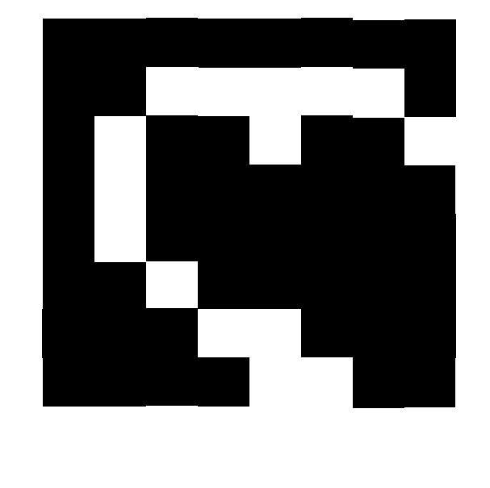
Working Principle of Encoder-Decoder
Encoding
Decoding
Initial Input
540x641
Encoded Latent Code
8x8
Generated Output
56x56
Encoder
Decoder
Encoder: Compresses input image to a lower-dimensional latent code.
Latent code: Compressed representation of the input.
Decoder: Expands latent code to the output image.
Loss function: Compares output to the target image.
Optimization: Minimizes loss for accurate image generation.
Generation: Encodes random noise to generate new images.

